Slide 1

NAME: PRASAD GUDIVADA
PROJECT NAME : KEYLOGGER AND SECURITY
GIT HUB:

Slide 2
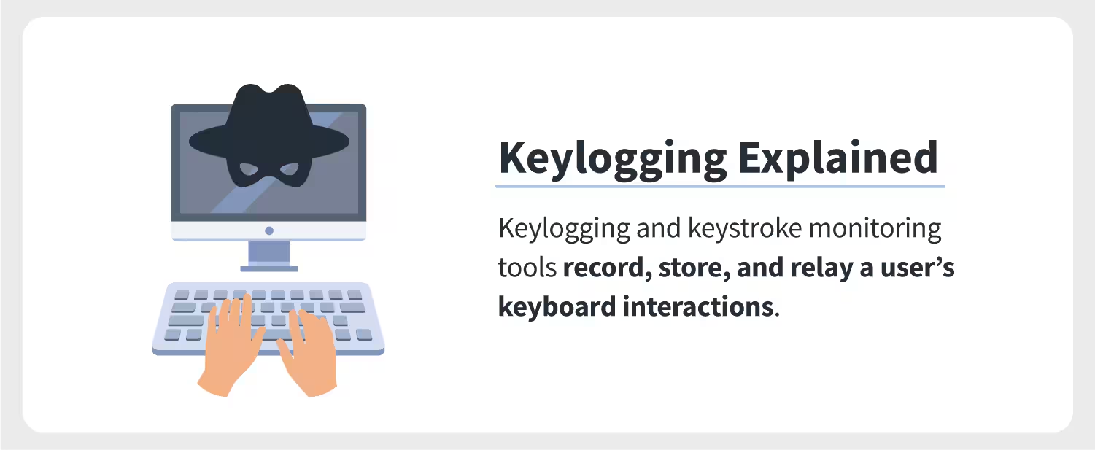
KEYLOGGER AND SECURITY

Slide 3





AGENDA
Introduction
Problem Statement
Project Overview
End Users
Solution & Value its Proposition
WOW in the solutions
Modelling
Results
Conclusion and Q&A
3/21/2024 Annual Review

Slide 4

INTRODUCTION
Understanding How They Work
A Keylogger, also known as a keystroke logger , is like a silent observer in the digital world .
Imagine it as a tiny spy sitting inside your keyboard, meticulously recording every key
you press.
Whether you’re typing a heartfelt email, entering a password, or crafting a code snippet,
the keylogger diligently notes it all.

Slide 5




PROBLEM STATEMENT
A keylogger is a software or hardware tool that secretly records every keystroke made on a computer or mobile device.
Its primary purpose is to monitor and capture the keys pressed on a keyboard, including letters, including letters, numbers, symbols, and special characters .
Keyloggers can be used for legitimate purposes (such as monitoring
employee productivity) or maliciously (for stealing sensitive information).

Slide 6

PROJECT OVERVIEW
Develop a comprehensive understanding of keyloggers, their type , how to work , and effective security measures to prevent keylogging attacks.
Scope:
Development Phase:
Design and implement a basic keylogger using programming languages and libraries.
Testing Phase:
Test the keylogger in a controlled environment to evaluate its functionality.
Analysis Phase:
Analyze the captured data to understand the keylogger’s effectiveness.

Slide 7
END USERS
End Users are the individuals within an organization who regularly engage with digital platforms, applications, and devices . They play a crucial role as the first line of defense against cyber threats.
Organizations : Companies and institutions that need to ensure compliance with usage policies, enhance security, and monitor employee productivity.
System Administrators: IT professionals responsible for managing and securing computing environments within an organization.

Slide 8

SOLUTION AND ITS VALUE PROPOSITION
Creation for Educational and Defensive Purposes:
Purpose: An ethical keylogger is designed to be used as a tool for educational and defensive cybersecurity purposes.
Educational Use:
Demonstrates how keyloggers operate, providing insights into their mechanisms and behaviors.
Defensive Use:
Assists in developing robust security measures by understanding potential vulnerabilities exploited by malicious keyloggers.
Defensive Strategies:
Building Resilience:
Helps in creating more resilient security systems by knowing the tactics and techniques used by attackers.
Enhanced Detection:
Contributes to the development of advanced detection tools and methods to identify and neutralize keyloggers.

Slide 9

THE WOW IN OUR SOLUTION
Steps for process of keylogger and security
User input Device (keyboard)
2.Keylogger (software/Hardware)
3.Data capture Module
4. Data Storage Module
5.Data Transmission module (for remote keyloggers)
6.Attacher’s Server.
start-> Initialize Keylogger-> Capture Keystrokes->Process Keystrokes
Store Locally (local file)
Transmit to Remote Server
Continue Capturing Keystrokes
Stop
3/21/2024 Annual Review
9

Slide 10
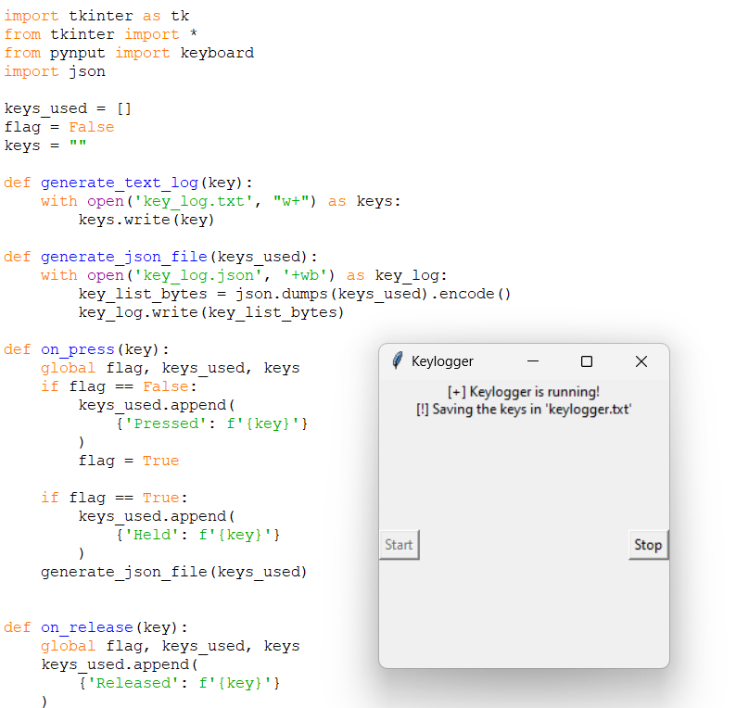
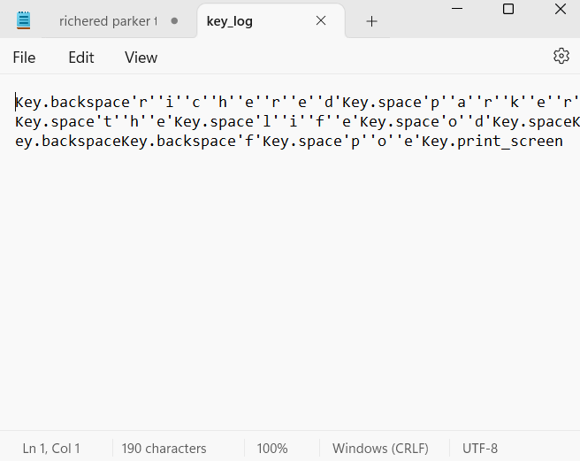
MODELLING
Code shows the module that loads the keystrokes of the keyboard the output stores in the another file named as “key log”
10

Slide 11
RESULT
The keyloggers captures and logs keystrokes in real – time ,successfully
Displaying them in the user interface.
Performance metrics show minimal system impact and secure data transmission to the server.
Keyloggers can be used for legitimate purposes , such as employee monitoring , but they are often associated with malicious activities like identify theft, financial fraud
11

Slide 12
THANK YOU
GITHUB :
https://github.com/Prasad9047200/keylogger-and-security-.git
12

